Slide 1
Database design and Applications CSIZG518/SEZG518/SSZG518)(S1-21)
Uma Maheswari

Slide 2
Session 1
Introduction to Database Management Systems (DBMS)
Concepts and Architecture

Slide 3
Learning Objective
Introduction to Database Management Systems
Advantages of using DBMS
Three-schema architecture and Data independence
DBMS Architecture
Database Users
Refer : T1-Chapter 1 and 2;
Sections: 1.1-1.6, 2.1, 2.2, 2.4
BLOG: https://umacmv.wordpress.com/

Slide 4
You are Exptected to learn these before this Session:
Database Systems
DBMS
Database System Environment
Traditional File Systems
Advantages of DBMS over File Systems
Disadvantages of DBMS
Describing and Storing data in DBMS
Three Schema Architecture
Data Independence
Queries
Transactions
Structure of DBMS
Users of DBMS
TODAYs CONTACT SESSION: We discuss important concepts like advantages of using DBMS over traditional file systems; Three schema architecture; Data independence; DBMS architecture.

Slide 5
What is Database ?
A unit of Information is called DATUM while DATA is plural. So DATA is
Collection of related data
By data , we mean known facts that can be recorded and that have implicit meaning.
Represents some aspect of the real world
Logically coherent collection of data with inherent meaning
Built for a specific purpose
This collection of related data with an implicit meaning is a database.

Slide 6
What is Database ?
Examples of Database:
employee database (contains all about employees from one or more branches of an organization),
sales database (contains all about sales and salesperson from one or more branches of an organization),,
user database (all who uses the system and credentials and log details) and so on.

Slide 7
Types of Data
Examples
Character | A N $
Number | 12
 | 56.9
 | 54/78
 | -5.6777
 | 89,677
Date | 03-08-2019 1/5/2018
Currency | $56678 Rs 34900
Boolean | 1 or 0 true or false
Sets | RED, YELLOW, GREEN BLUE} {USD, INR, AUD, EURO, POUND}

Slide 8
DBMS and its OPERATIONS

Slide 9
What is Database management system (DBMS) ?
Collection of programs
Enables users to create and maintain a database
Def:
The DBMS is a general-purpose software system that facilitates the processes of defining, constructing, manipulating, and sharing databases among various users and applications
How do we share the DB ?
Server

Slide 10
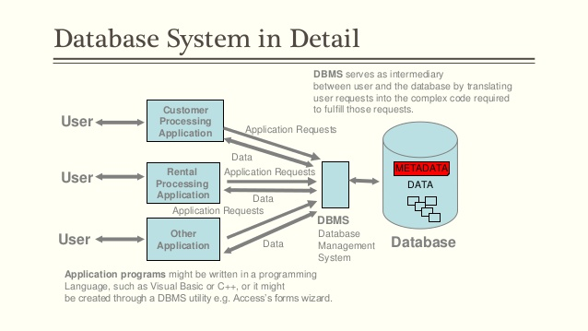
How does DBMS Look?

Slide 11
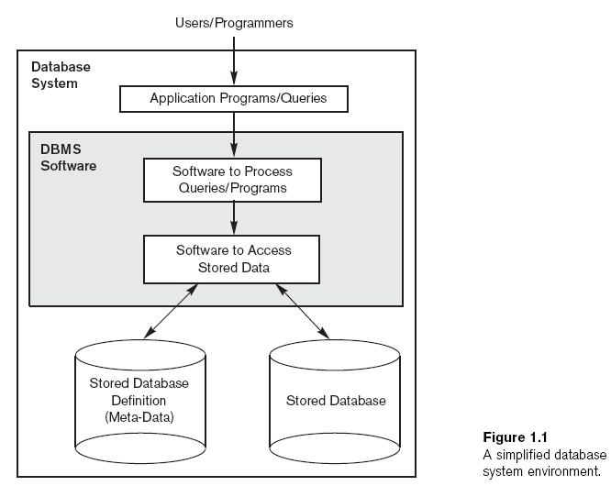
DBMS environment

Slide 12
What operations can you do with DBMS?
Defining a database
Constructing the database
Manipulating a database
Sharing a database
Query a database

Slide 13
DBMS operations in detail
Defining a database
Specify the data types, structures, and constraints of the data to be stored.
The database definition or descriptive information is also stored by the DBMS in the form of a database catalog or dictionary; it is called meta-data.
Constructing the database is the process of storing the data on some storage medium that is controlled by the DBMS.
Manipulating a database includes functions such as querying the database to retrieve specific data, updating the database and generating reports from the data.

Slide 14
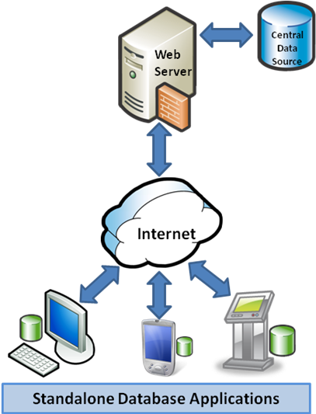
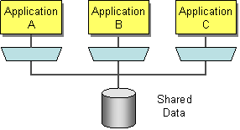
What is sharing operation in DBMS?
Sharing a database allows multiple users and programs to access the database simultaneously.

Slide 15
How do we access Database from application programs?
An application program can access a database by sending queries to DBMS using:
Three main integration approaches:
– Embed SQL in the host language (Embedded SQL)
– Create special API to call SQL commands (JDBC,ODBC)
– Allow ‘external’ code to be executed from within SQL
What is Query ?
A DBMS operation that causes some data to be retrieved
Notes:
A query is like asking question to db.

Slide 16
Embedded SQL
{
int a;
/* ... */
EXEC SQL SELECT salary INTO :a
FROM Employee
WHERE SSN=876543210;
/* ... */
printf("The salary is %d\n", a);
/* ... */
}

Slide 17
Using SQL in API call
app.post("/api/getAllcustomers", (req, res) => {
const {eid } = req.body;
console.log("eid is ..",eid);
pool.queery
"SELECT * FROM customers WHERE customercity= $1",
[eid],
(error, results) => {
if (error) {
console.log(error);
res.status(203);
}
else {
res.status(200).json(results.rows);
}
});
});

Slide 18
Allow ‘external’ code to be executed from within SQL
EXAMPLE OF PYTHON CODE EXECUTION IN SQL SERVER
To allow the use of external scripts in the Python language, you must enable the system parameter “external scripts enabled” in SQL Server, this is done using the system procedure sp_configure.
sp_configure 'external scripts enabled', 1;
RECONFIGURE WITH OVERRIDE
EXECUTE sp_execute_external_script
@language = N'Python',
@script = N'
a = 1
b = 2
c = a+b
print ("Example instruction on Python")
print("Result =", c)';

Slide 19
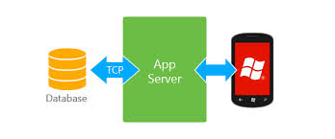
Mobile accessing a database?
Notes:
Using its application server.

Slide 20
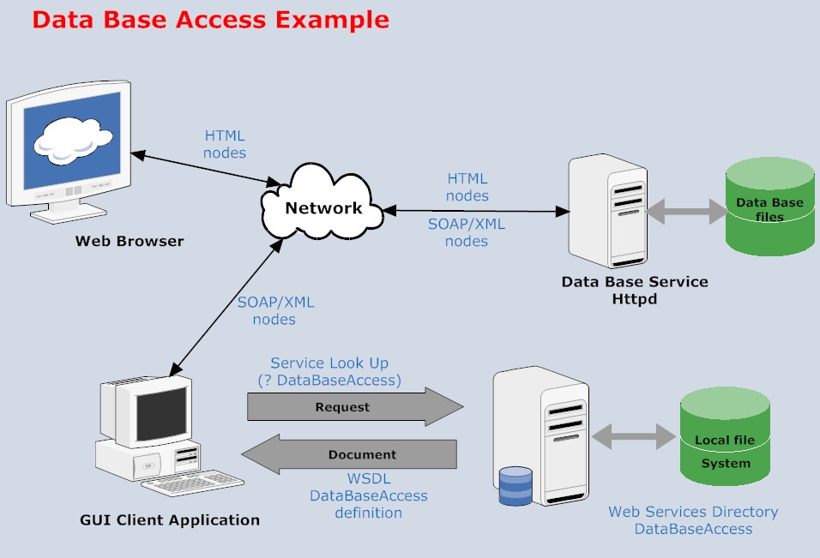
Example DBMS access

Slide 21
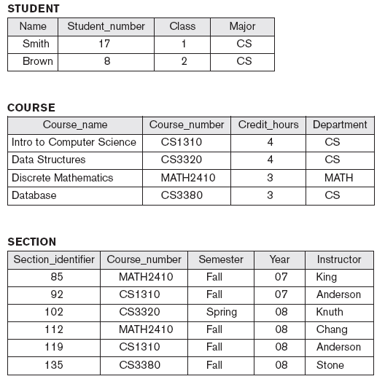
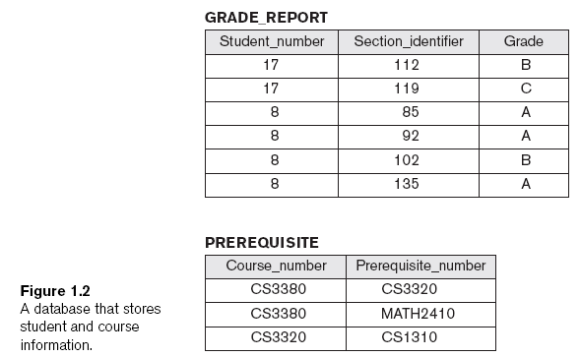
UNIVERSITY Database design:

Slide 22
Examples of Queries and Updates:
Examples of queries:
Retrieve the transcript
List the names of students who took the section of the ‘Database’ course offered in fall 2008 and their grades in that section
List the prerequisites of the ‘Database’ course
Examples of updates:
Change the class of ‘Smith’ to sophomore
Create a new section for the ‘Database’ course for this semester
Enter a grade of ‘A’ for ‘Smith’ in the ‘Database’ section of last semester

Slide 23
Features of DBMS
The features of DBMS are:
Data Independence,
Back-up and Restore,
Transaction and Concurrency Control,
Data Security
Data Integrity.

Slide 24
Protection for DB?
Protection includes:
System protection (against hardware or software malfunction (or crashes))
Security protection (against unauthorized or malicious access)
Hacking db

Slide 25
What is “Maintain the DB system” ?
Allow the system to evolve as requirements change over time
Therefore it is an activity designed to keep a database running smoothly.
A number of different systems can do this:
1. performed by people who are comfortable and familiar with the database system and the specifics of the particular database
2. Databases are used to maintain a library of information in a well organized, accessible format. Database maintenance is used to keep the database clean and well organized so that it will not lose functionality.
3. Backing up the data
4. Checking for signs of corruption in the database
5. Server maintenance.
Notes:
DB is not static, however, because changes are constantly being made as material is added, removed, and moved around in real world therefore to be reflected in DB also. People may also change parameters within the database, decide to use different indexing systems, and so forth. Over time, this can cause the database to start to malfunction. Database maintenance is used to keep the database clean and well organized so that it will not lose functionality.
BACKUP is maintaining a database is simply backing up the data so that, if anything happens, there will be another copy available. Some databasing systems actually do this automatically, sending a backup to another location every day, every week, or within any other set period of time.
checking for signs of corruption in the database, looking for problem areas, rebuilding indexes, removing duplicate records, and checking for any abnormalities in the database that might signal a problem. The goal is to keep the database operating smoothly for user.
server maintenance involves confirming that databases are working properly. This also includes checks for security flaws and other issues that could threaten the integrity of the database, ranging from viruses to records which are entered improperly.

Slide 26
Database approach
Characteristics of the Database Approach :
1. Self-describing nature of a database system
2. Insulation between programs and data, and data abstraction
3. Support of multiple views of the data
4. Sharing of data and multiuser transaction processing

Slide 27
Database approach
Self-Describing Nature of a Database System
Database system contains complete definition of structure and constraints.
Meta-data
Describes structure of the database
Database catalog used by:
DBMS software
Database users who need information about database structure
Notes:
A fundamental characteristic of the database approach is that the database system
contains not only the database itself but also a complete definition or description of
the database structure and constraints. This definition is stored in the DBMS catalog,
which contains information such as the structure of each file, the type and storage
format of each data item, and various constraints on the data. The information
stored in the catalog is called meta-data, and it describes the structure of the primary
database

Slide 28
Database approach
2. Insulation between programs and data implies “data abstraction”
Program-data independence
Structure of data files is stored in DBMS catalog separately from access programs
Program-operation independence
Operations specified in two parts:
Interface includes operation name and data types of its arguments
Implementation can be changed without affecting the interface
Notes:
1. An operation (also called a function or method) is specified in two parts.
The interface (or signature) of an operation includes the operation name and the
data types of its arguments (or parameters).
2. The implementation (or method) of the
operation is specified separately and can be changed without affecting the interface.
3. User application programs can operate on the data by invoking these operations
through their names and arguments, regardless of how the operations are implemented.
This may be termed program-operation independence.
4. The characteristic that allows program-data independence and program-operation
independence is called data abstraction.

Slide 29
Database Approach
3. Support of multiple views of the data
View
Subset of the database
Contains virtual data derived from the database files but is not explicitly stored
Multiuser DBMS
Users have a variety of distinct applications
Must provide facilities for defining multiple views

Slide 30
Database Approach
Multiple views of the data

Slide 31
Database Approach
4. Sharing of data and multiuser transaction processing
Allow multiple users to access the database at the same time
Concurrency control software
Ensure that several users trying to update the same data do so in a controlled manner
Result of the updates is correct
Online transaction processing (OLTP) application
A multiuser DBMS software is to ensure that concurrent transactions operate correctly and efficiently.

Slide 32
What is Transaction in DB?
May cause some data to be read and some data to be written into the database
Eg.,
When you credit or debit in your bank account
Notes:
Eg., what happens when do a credit or debit and it updates the balance in your account.

Slide 33
Types of Database Approach

Slide 34
Types of Database Approach
Traditional file processing
Each user defines and implements the files needed for a specific software application
Database approach
Single repository maintains data that is defined once and then accessed by various users

Slide 35
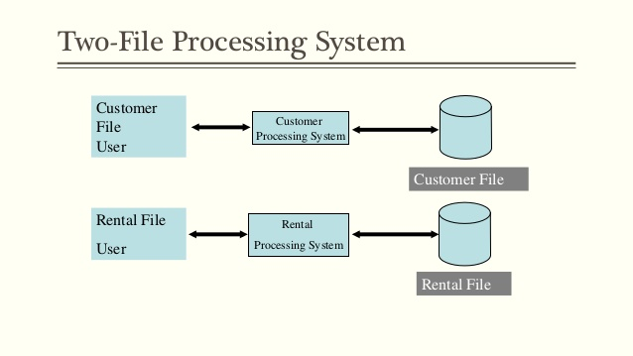
Traditional file processing

Slide 36
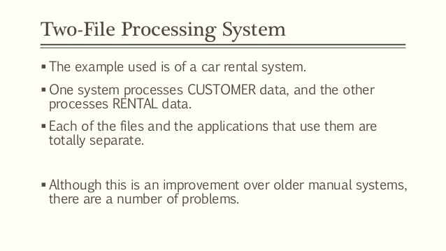
Traditional file processing

Slide 37
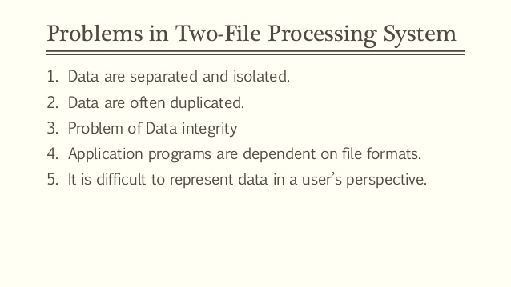
Traditional file processing

Slide 38
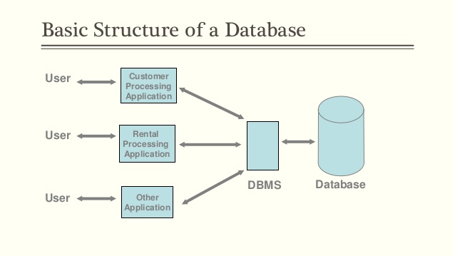
Database approach

Slide 39
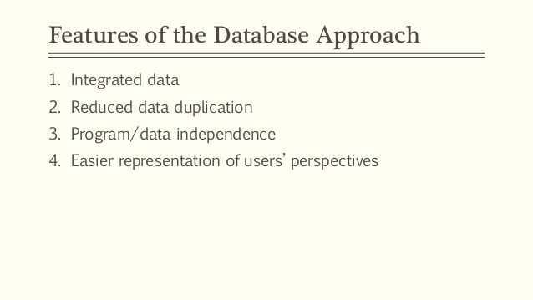
Database approach

Slide 40
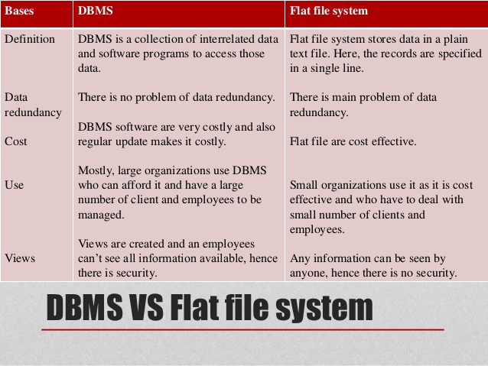
DBMS vs Flat file system

Slide 41
DBMS ARCHITECTURE

Slide 42
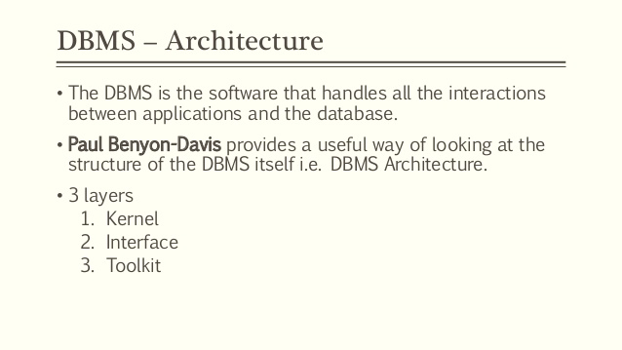
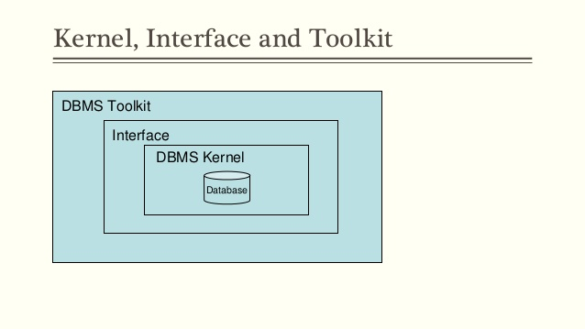
DBMS ARCHITECTURE

Slide 43
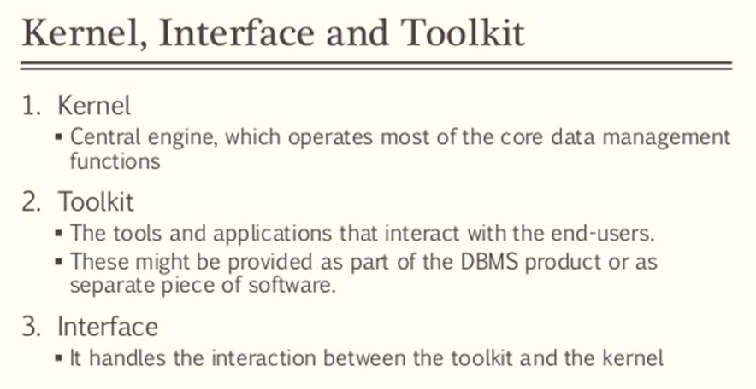
DBMS ARCHITECTURE

Slide 44
DBMS ARCHITECTURE

Slide 45
DB architecture
Database Architecture:
Database architecture deals the design, development, implementation and maintenance of computer programs that which store and organize information for businesses, agencies and institutions. The development and implementation software to meet the needs of users is done by Data Architect.
Design of DBMS depends on its architecture which can be centralized or hierarchical.
Data Abstraction: Hiding the implementation and storage details of DB or database.

Slide 46
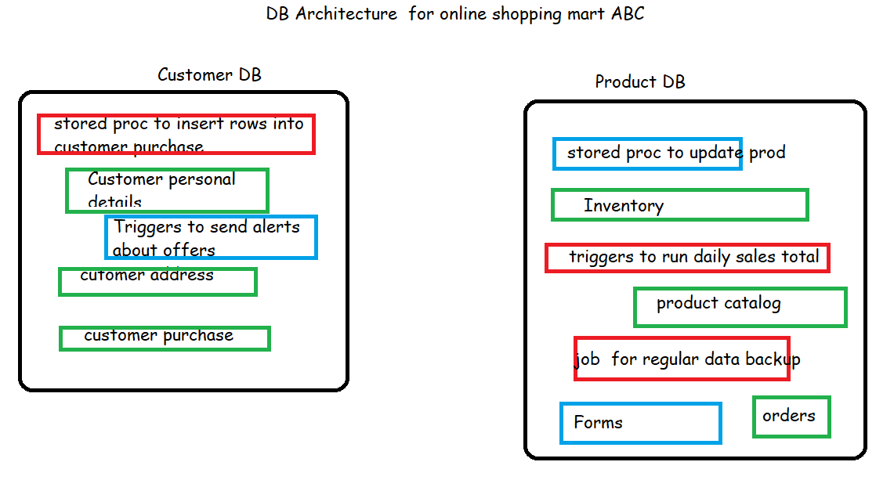
Example of DB architecture
Green ones are tables ,

Slide 47
Three-schema architecture

Slide 48
Concept of 3 level or layers of DB
Each Layer has to handle two issues
How to store data
Specify how to view the stored data
Level 1
level2
level3

Slide 49
Levels of database architecture or three schema architecture
The 3 levels or layers of database or DBMS architecture which are External, conceptual or logical and physical or internal levels or layers.
Level has schema and data abstraction
There is a schema at each levels or layers of the Database architecture while there is a abstraction at each levels or layers as well.
These abstractions are called external, conceptual and physical level abstractions respectively.
These abstractions are needed to view data while the schema at each level describe data at some layer of visualization of the database.

Slide 50
External Schema
External schemas, which usually are also in terms of the data model of the DBMS, allow data access to be customized (and authorized) at the level of individual users or groups of users.
Any given database has exactly one conceptual schema and one physical schema because it has just one set of stored relations, but it may have several external schemas, each tailored to a particular group of users.
Each external schema consists of a collection of one or more views and relations from the conceptual schema.
SQL queries we place at this level

Slide 51
Conceptual Schema
conceptual schema (sometimes called the logical schema) describes the stored data in terms of the data model of the DBMS.
In a relational DBMS, the conceptual schema describes all relations that are stored in the database.
Faculty(d: string, fname: string, sal: real)
Courses(cid: string, cname: string, credits: integer)
Rooms(rno: integer, address: string, capacity: integer)
Enrolled(sid: string, cid: string, grade: string)
Teaches(d: string, cid: string)
Meets In(cid: string, rno: integer, time: string
Design of conceptual schemas is called “Conceptual database design”

Slide 52
Physical Schema
The physical schema species additional storage details. Essentially, the physical schema summarizes how the relations described in the conceptual schema are actually stored on secondary storage devices such as disks and tapes.
We must decide what file organizations to use to store the relations, and create auxiliary data structures called indexes to speed up data retrieval operations.
indexes could be by hashing or trees
Decisions about the physical schema are based on an understanding of how the data is typically accessed. The process of arriving at a good physical schema is called physical database design..

Slide 53
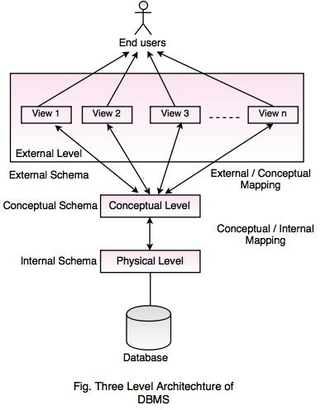
3 Layer architecture

Slide 54
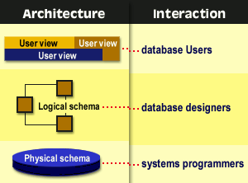

Slide 55
Data Independence
A database system normally contains a lot of data in addition to users’ data.
For example,
it stores data about data, known as metadata, to locate and retrieve data easily. It is rather difficult to modify or update a set of metadata once it is stored in the database.
But as a DBMS expands, it needs to change over time to satisfy the requirements of the users. If the entire data is dependent, it would become a tedious and highly complex job.

Slide 56
DATA INDEPENDENCE
Data Independence
Data Independence is defined as a property of DBMS that helps you to change the Database schema at one level of a database system without requiring to change the schema at the next higher level. Data independence helps you to keep data separated from all programs that make use of it.
Data abstraction or abstraction at each level makes this data independence possible.
Types of data independence
There are two types namely logical and physical data independence.

Slide 57
DATA INDEPENDENCE
Logical data independence:
Logical data is data about database, that is, it stores information about
how data is managed inside.
For example, a table (relation) stored in the database and all its constraints, applied on that relation.
So Logical data independence is a kind of mechanism, which liberalizes itself from actual data stored on the disk. If we do some changes on table format, it should not change the data residing on the disk.

Slide 58
DATA INDEPENDENCE
2. Physical data independence:
All the schemas are logical, and the actual data is stored in bit format on the disk.
Physical data independence is the power to change the physical data without impacting the schema or logical data.
For example, in case we want to change or upgrade the storage system itself − suppose we want to replace hard-disks with SSD − it should not have any impact on the logical data or schemas.

Slide 59
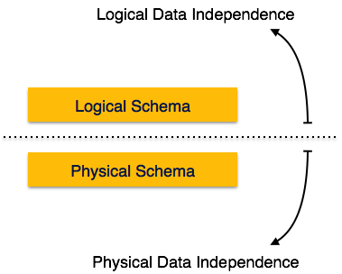
Data Independence
Metadata itself follows a layered architecture, so that when we change data at one layer, it does not affect the data at another level. This data is independent but mapped to each other.

Slide 60
Mapping
Mapping: Mapping is used to transform the request and response between various database levels of architecture. There are two types of mapping namely external and Internal mapping.
In External / Conceptual mapping, it is necessary to transform the request from external level to conceptual schema.
In Conceptual / Internal mapping, DBMS transform the request from the conceptual to internal level.
Mapping is not good for small database, because it takes more time.

Slide 61
Mapping

Slide 62
Types of DBMS Archotecture
Types of DBMS Architecture
The types of DBMS architectures are single tier or multi -tier. The n-tier architecture divides the whole system into related but independent n modules which can be modified, altered, changed or replaced independently. There are different layers like presentation layer(UI), application layer (business logic or programs) and data layer where actual database is stored.
1-tier architecture is where the user sits directly on the DBMS and all changes done by DBMS itself. Thus no client or server.

Slide 63
Client Server concept
Client and Server concept
The DBMS may be on a centralized machine or server. The clients or end users or programs be it standalone or web/mobile applications accessing the database on the server. There could be several users or apps trying to read or write data on the database located on server.

Slide 64
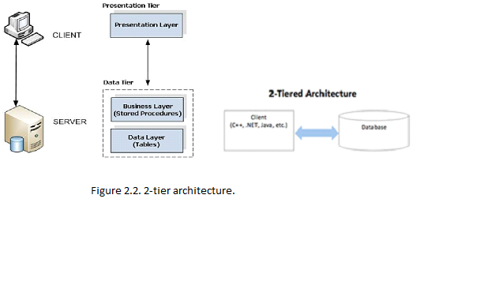
DBMS Architecture
2-tier architecture is where the presentation or UI or app is on your mobile or computer which is the client program and Server which has the database. The Database is on server so it could be treated that data is safe from unauthorised users.

Slide 65
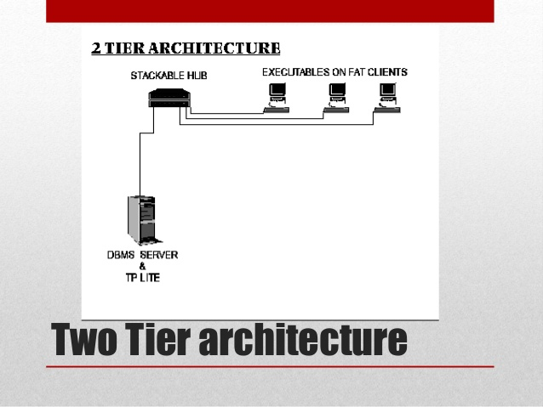
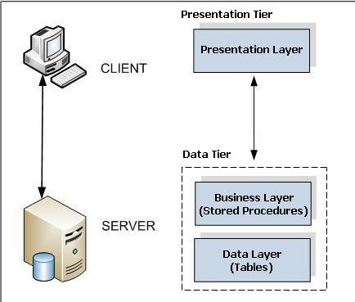
DBMS ARCHITECTURE – 2 TIER

Slide 66
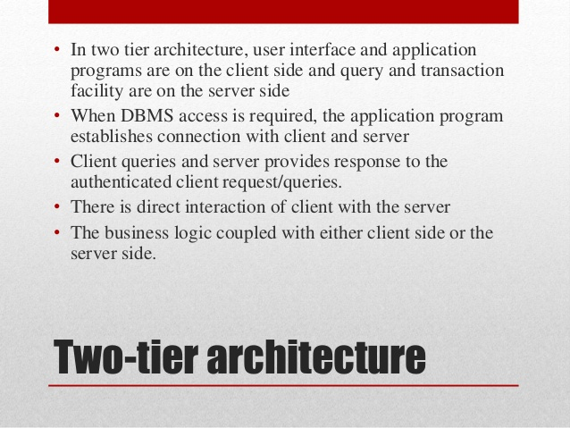
DBMS ARCHITECTURE – 2 TIER
Notes:
The user interface programs and application programs can run on the client side.
When DBMS access is required, the program establishes a connection to the DBMS
(which is on the server side); once the connection is created, the client program can
communicate with the DBMS.
A standard called Open Database Connectivity
(ODBC) provides an application programming interface (API), which allows
client-side programs to call the DBMS, as long as both client and server machines
have the necessary software installed.
Most DBMS vendors provide ODBC drivers for their systems.
Java programming language, called JDBC

Slide 67
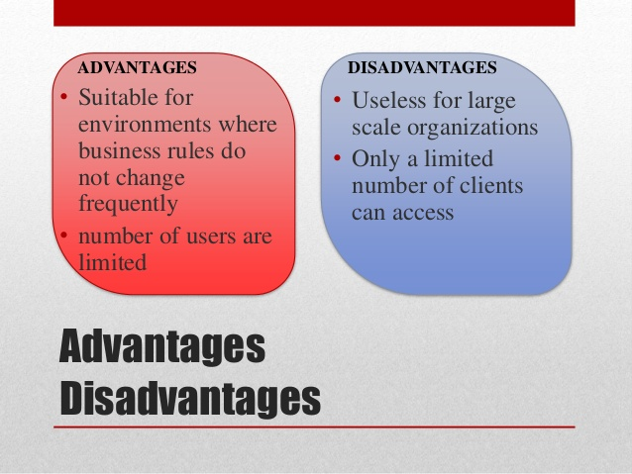
DBMS ARCHITECTURE – 2 TIER

Slide 68
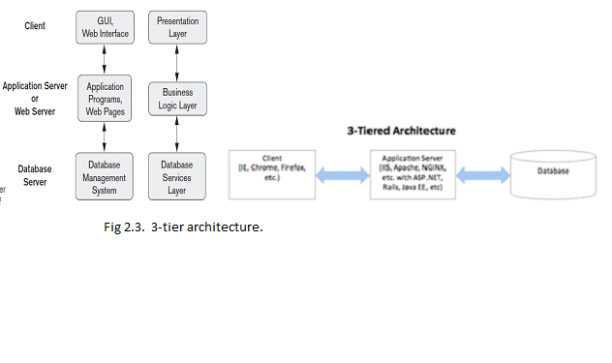
DBMS ARCHITECTURE – 3 TIER
3-tier architecture is where there are 3 layers or modules. The client or presentation layer which is app on mobile or computer and server which has the application layer containing business logic modules. The data layer contains the actual databases.

Slide 69
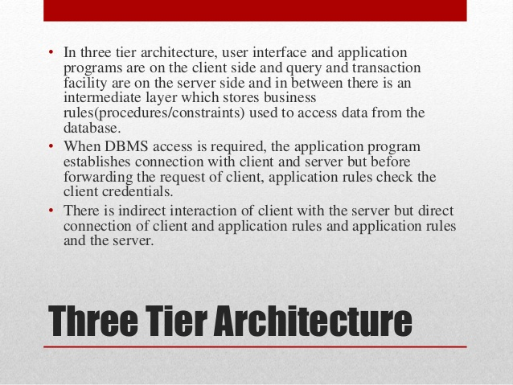
DBMS ARCHITECTURE – 3 TIER

Slide 70
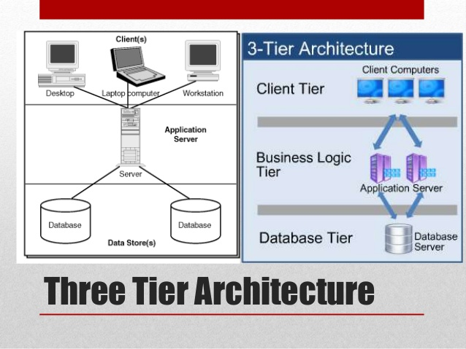
DBMS ARCHITECTURE – 3 TIER

Slide 71
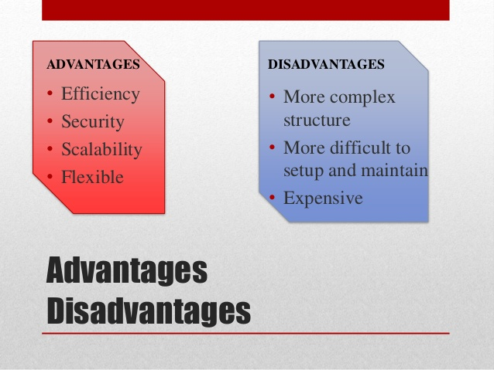
DBMS ARCHITECTURE – 3 TIER

Slide 72
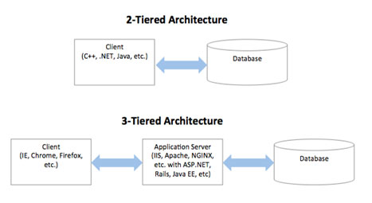
DBMS ARCHITECTURE

Slide 73
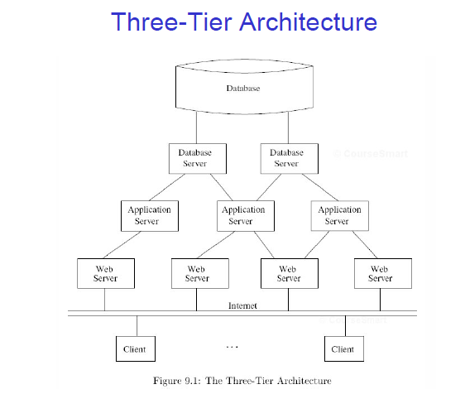
Example of Three-Tier Architecture
A common environment for using a database has three tiers of processors:
Web servers --- talk to the user.
Application servers --- execute the business logic.
Database servers --- get what the app servers need from the database.

Slide 74
DATA MODEL AND ITS
TYPES

Slide 75
Data Model
Data Model can be defined as an integrated collection of concepts for describing and manipulating data, relationships between data, and constraints on the data in an organization.
Data model hides storage and implementation details that are not of interest to most database users is called abstraction. There are different types of data models.
Types of Data Model are:
The data models are classified as Record based logical models which are Hierarchical Model, Relational Model and Network Database Model.
The high-level data model like ER or semantic model. Finally a object Model.

Slide 76
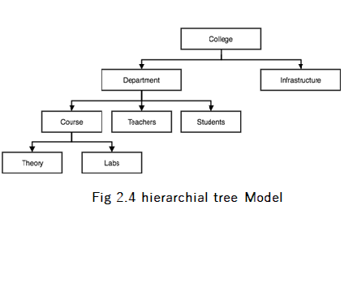
Data Model
1. Hierarchial model: This model organises data into a tree-like-structure, with a single root, to which all the other data is linked. The heirarchy starts from the Root data, and expands like a tree, adding child nodes to the parent nodes. In this model, a child node will only have a single parent node. This model efficiently describes many real-world relationships like index of a book, recipes so on covering one to many relationships between different types of data.
Examples : IBM’s IMS (Information Management. System)

Slide 77
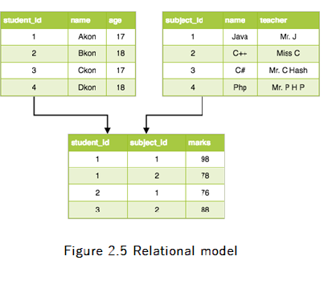
Data Model
2. Relational model: In this model, data is organised in two-dimensional tables and the relationship is maintained by storing a common field. The basic structure of data in the relational model is tables. All the information related to a particular-type is stored in rows of that table. Hence, tables are also known as relations in relational model fig 2.5
Examples: Oracle, IBM DB2, MySQL, Informix,Sybase, MsAccess,Ingress, postgres

Slide 78
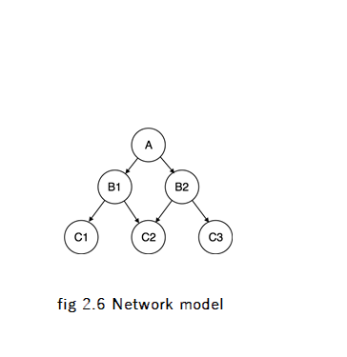
Data Model
3.Network model: an extension of the Hierarchical model. In this model data is organised more like a graph, allowed to have more than one parent node. In this database model data is more related as more relationships are established in this database model. Also, as the data is more related, hence accessing the data is also easier and fast. This database model was used to map many-to-many data relationships. This was the most widely used database model, before Relational Model was introduced fig 2.6
Examples : GE s Integrated Data Store IDS

Slide 79
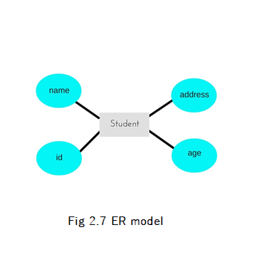
Data Model
4. ER model: In this data model relationships are created by dividing object of interest into entity and its characteristics into attributes. Different entities are related using relationships. E-R Models are defined to represent the relationships into pictorial form to make it easier for different stakeholders to understand. This model is good to design a database, which can then be turned into tables in relational model

Slide 80
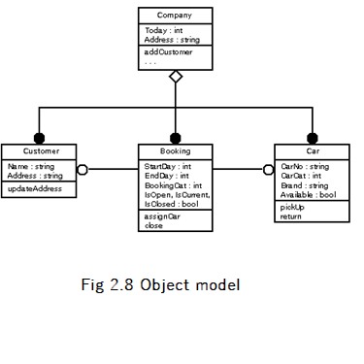
Data Model
5.Object Model: Object model stores the data in the form of objects, classes and inheritance.
This model handles more complex applications, such as Geographic Information System (GIS), scientific experiments, engineering design and manufacturing. It is used in File Management System. It represents real world objects, attributes and behaviour. It provides a clear modular structure. It is easy to maintain and modify the existing code
Example : Object store

Slide 81
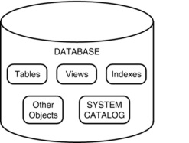
What all are stored in DB?

Slide 82
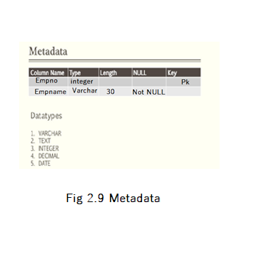
What is METADATA?
Metadata : Data about data is meta data. It describes about itself.
Example

Slide 83
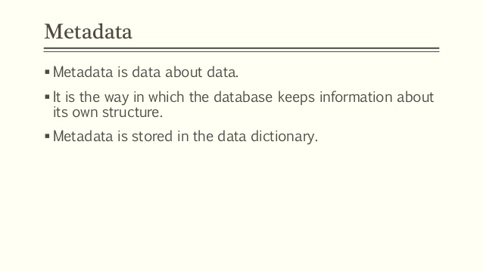
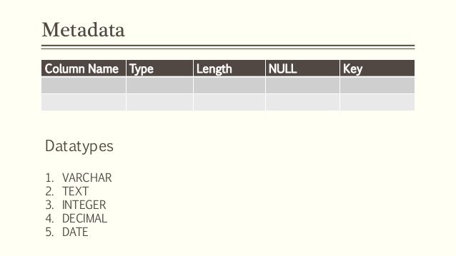
What is Meta data?

Slide 84
Database Catalog
Database Catalog: The database catalog of a database instance consists of metadata in which definitions of database objects such as
base tables,
views (virtual tables),
constraints,
synonyms,
value ranges,
indexes,
users and user groups are stored.
A database catalog is a function included on a server that allows users and administrators to check information on every database installed on that server.
Along with common information, a database catalog also holds metadata on every database, such as how many tables and rows are being used in a particular database.

Slide 85
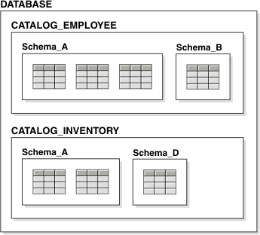
Database Catalog
Notes:
DBMS catalog, which contains information such as the structure of each file, the type and storage
format of each data item, and various constraints on the data. The information
stored in the catalog is called meta-data, and it describes the structure of the primary
database

Slide 86
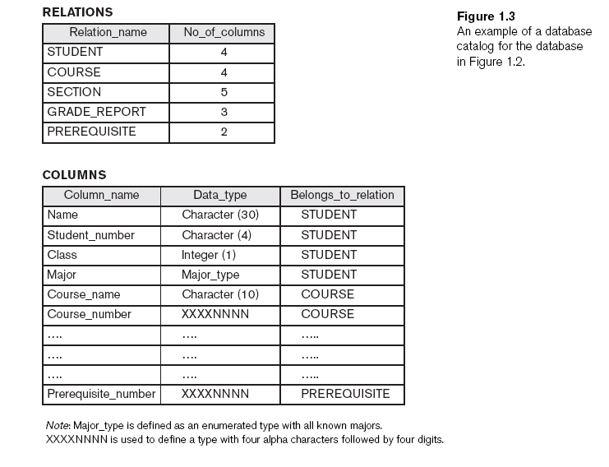
Example of Database Catalog

Slide 87
System Catalog
Information in the system catalog defines the structure of the database.
The system catalog consists of tables and views that describe the structure of the database. Sometimes called the data dictionary, these table objects contain everything that the database knows about itself.
Each system catalog table contains information about specific elements in the database.
So A system catalog is created and maintained for each database created .
For example, the DDL (data dictionary language) for all tables in the database is stored in the system catalog.

Slide 88
SYSTEM CATALOG
Every database stores every information about its objects. These information can be structure, definition, purpose, storage, number of columns and records, dependencies, access rights, owner and other info.
These useful information about the data in the database ,also called as metadata. These metadata are also stored as rows and columns of a table.
Collection of these metadata is stored in the system catalog or data dictionary.
When the database is created a system catalog is automatically created as well.
This catalog keeps track of the objects created and changes made to each objects in the database. Every database has its own system catalog.

Slide 89
System Catalog and Query
Information about the conceptual, external, and physical schemas is stored
in the SYSTEM CATALOGS.
Data independence is achieved through use of the three levels of data abstraction.
The data independence are of two kinds logical and physical data independence
Queries in a DBMS :
Queries : Questions involving the data stored in DBMS.
Types of queries : Formal query language -> Relational Algebra and
Relational Calculus
commercial query language -> SQL statements

Slide 90
Data Dictionary
Creating a Data Dictionary for Online Delivery System
Delivery Table – This table contains details about the delivery
Primary Key Attribute Data Type Size Description
Y Delivery_id INTEGER - Unique ID of delivery
Delivery_date Date - Date of the delivery
Delivery_person_name VARCHAR 50 Name of the person who does the delivery of specific order
Delivery_person_contact VARCHAR 20 Name of the person who does the delivery of specific order
Order Table – This table contains details about order
PrimaryKey Attribute Data Type Size Description
Y Order_id INTEGER - Unique Id of order
Cust_id INTEGER - Unique ID of customer
Delivery_id INTEGER - Unique ID of delivery
Date Date - Date of a specific order
Branch_id INTEGER - Unique ID of the branch

Slide 91
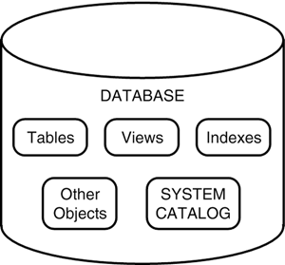
SYSTEM CATALOG
Who creates system catalog?
When you create a database the system catalog is automatically created by DBMS.

Slide 92
SYSTEM CATALOG
The system catalog contains information such as the following:
User accounts and default settings
Privileges and other security information
Performance statistics
Object sizing
Object growth
Table structure and storage
Index structure and storage
Information on other database objects, such as views, synonyms, triggers, and stored procedures
Table constraints and referential integrity information
User sessions
Auditing information
Internal database settings
Locations of database files

Slide 93
DBMS Functions, Pros and cons.

Slide 94
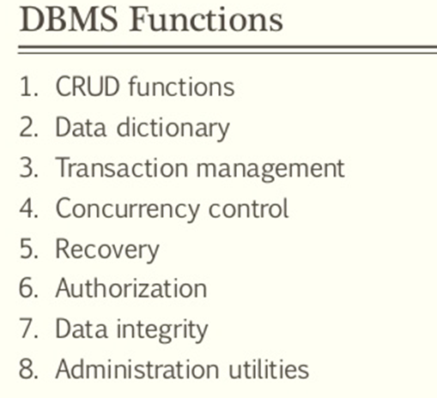
DBMS

Slide 95
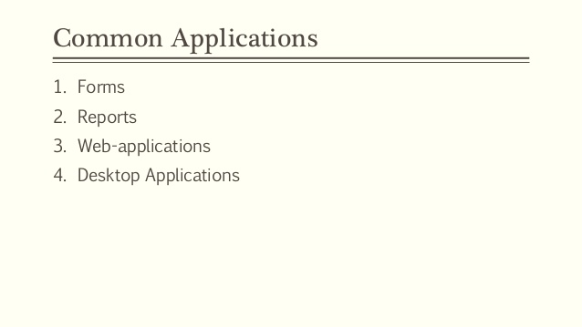
DBMS Applications

Slide 96
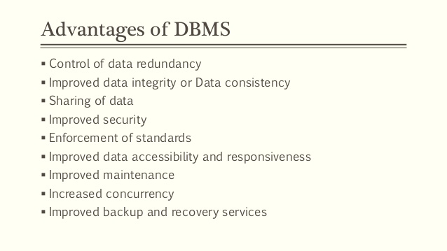
DBMS Advantages
Notes:
Controlling redundancy
Data normalization
Denormalization
Sometimes necessary to use controlled redundancy to improve the performance of queries
Restricting unauthorized access
Security and authorization subsystem
Privileged software
Providing storage structures and search techniques for efficient query processing
Indexes
Buffering and caching
Query processing and optimization
Providing persistent storage for program objects
Complex object in C++ can be stored permanently in an object-oriented DBMS
Impedance mismatch problem
Object-oriented database systems typically offer data structure compatibility
Providing backup and recovery
Backup and recovery subsystem of the DBMS is responsible for recovery
Providing multiple user interfaces
Graphical user interfaces (GUIs)
Representing complex relationships among data
May include numerous varieties of data that are interrelated in many ways
Enforcing integrity constraints
Referential integrity constraint
Every section record must be related to a course record
Key or uniqueness constraint
Every course record must have a unique value for Course_number
Business rules A business rule is a rule that defines or constrains some aspect of business . Eg., a business rule might state that no credit check is to be performed on return customers
Inherent rules of the data model
Permitting inferencing and actions using rules
Deductive database systems
Provide capabilities for defining deduction rules
Inferencing new information from the stored database facts
Trigger
Rule activated by updates to the table
Stored procedures
More involved procedures to enforce rules
Additional implications of using the database approach
Reduced application development time
Flexibility
Availability of up-to-date information
Economies of scale

Slide 97
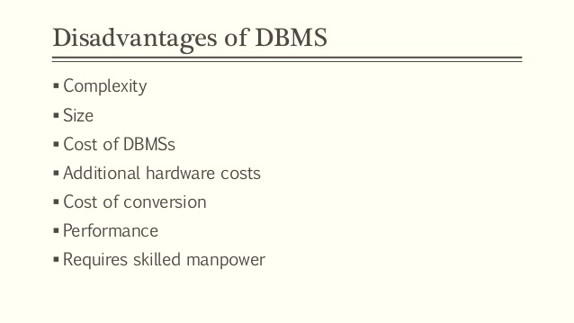
DBMS Disadvantages

Slide 98
HISTORY OF DBMS

Slide 99
HISTORY OF DBMS
1970-- Edgar Codd, at IBM's San Jose Research Laboratory, proposed a new data representation framework called the relational data model.
1980 --
The SQL query language for relational databases, developed as part of IBM's System R project, is now the standard query language. Object-oriented applications and the need for more complex databases Used in specialized applications: engineering design, multimedia publishing, and manufacturing systems

Slide 100
HISTORY OF DBMS
In late 1980s and the 1990s Specialized systems have been developed by numerous vendors for creating data warehouses, consolidating data from several databases, and for carrying out specialized analysis.
Interchanging data on the Web for e-commerce using XML
Extended markup language (XML) primary standard for interchanging data among various types of databases and Web pages
Emergence of several enterprise resource planning (ERP) and management resource planning (MRP) packages, which add a substantial layer of application-oriented features on top of a DBMS. Widely used packages include systems from Baan, Oracle, PeopleSoft, SAP, and Siebel.

Slide 101
HISTORY OF DBMS
After 1990’s DBMSs have entered the Internet Age.
While the first generation of Web sites stored their data exclusively in operating systems les, the use of a DBMS to store data that is accessed through a Web browser is becoming widespread.
Queries are generated through Web-accessible forms and answers are formatted using a markup language such as HTML, in order to be easily displayed in a browser.
All the database vendors are adding features to their DBMS aimed at making it more suitable for deployment over the Internet.

Slide 102
WHAT IS ERP OR CRM ?
These packages identify a set of common tasks (e.g., inventory management, human resources planning, financial analysis) encountered by a large number of organizations and provide a general application layer to carry out these tasks.
The data is stored in a relational DBMS, and the application layer can be customized to different companies, leading to lower overall costs for the companies, compared to the cost of building the application layer from scratch.
Extending database capabilities for new applications
Extensions to better support specialized requirements for applications
Enterprise resource planning (ERP)
Customer relationship management (CRM)
Databases versus information retrieval
Information retrieval (IR)
Deals with books, manuscripts, and various forms of library-based articles

Slide 103
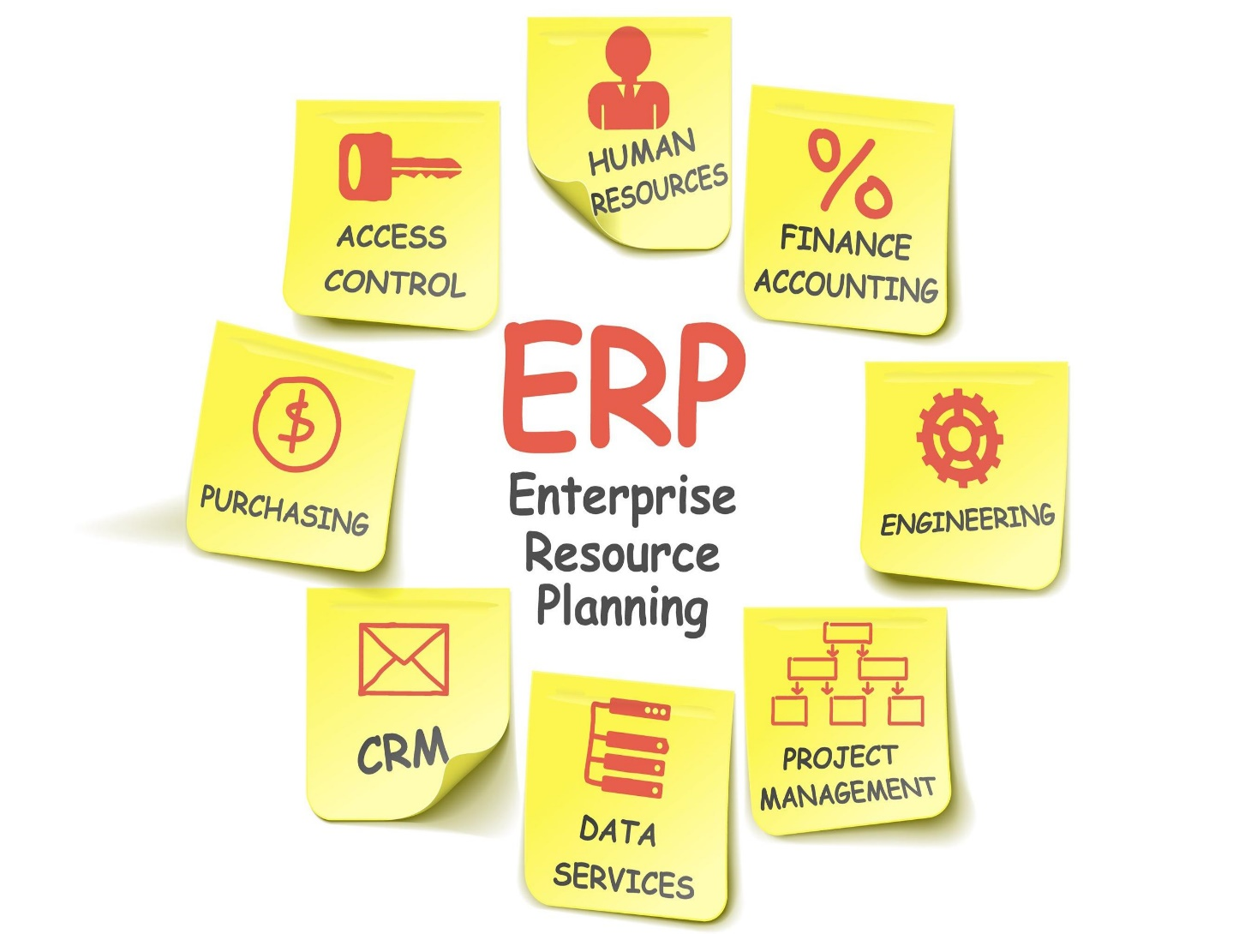
ERP
ERP applications are most commonly deployed in a distributed and often widely dispersed manner. While the servers may be centralized, the clients are usually spread to multiple locations throughout the enterprise.

Slide 104
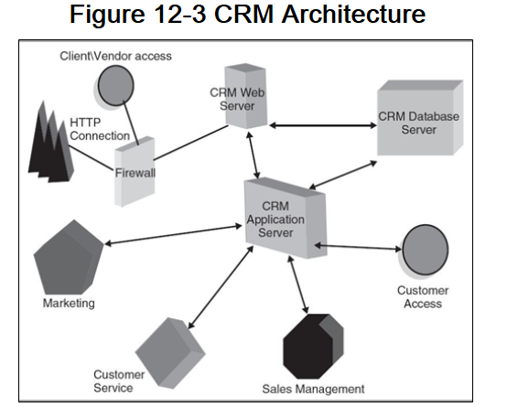
CRM
Customer Relationship Management(CRM) is a business strategy to acquire and manage the most valuable customer relationships. CRM requires a customer-centric business philosophy and culture to support effective marketing, sales and service processes.

Slide 105

TIMELINE OF DBMS

Slide 106
When Not to Use a DBMS
More desirable to use regular files for:
Simple, well-defined database applications not expected to change at all
Stringent, real-time requirements that may not be met because of DBMS overhead
Embedded systems with limited storage capacity
No multiple-user access to data

Slide 107
DBMS WORKERS or Users
System analysts
Determine requirements of end users
Application programmers
Implement these specifications as programs
DBMS system designers and implementers
Design and implement the DBMS modules and interfaces as a software package
Tool developers
Design and implement tools
Operators and maintenance personnel
Responsible for running and maintenance of hardware and software environment for database system

Slide 108
DBMS WORKERS or Users
Database administrators (DBA) are responsible for:
Authorizing access to the database
Coordinating and monitoring its use
Acquiring software and hardware resources
Database designers are responsible for:
Identifying the data to be stored
Choosing appropriate structures to represent and store this data
End users
People whose jobs require access to the database
Types
Casual end users
Naive or parametric end users
Sophisticated end users
Standalone users

Slide 109
Types of Databases and Database Applications
Traditional database applications
Store textual or numeric information
Multimedia databases
Store images, audio clips, and video streams digitally
Geographic information systems (GIS)
Store and analyze maps, weather data, and satellite images
Data warehouses and online analytical processing (OLAP) systems
Extract and analyze useful business information from very large databases
Support decision making
Real-time and active database technology
Control industrial and manufacturing processes

Slide 110
QUESTIONS??

Slide 111
QUESTIONS
What is the db model used after social networks gained importance in the market, such database became common in the industry ????

Slide 112

ANSWER
NoSQL I
known as “Not Only SQL”.
When people realized that unstructured text carry tonnes of information which they are unable to mine using RDBMS, they started exploring ways to store such datasets.
Anything which is not RDBMS today is loosely known as NoSQL. After social networks gained importance in the market, such database became common in the industry. Following is an example where it will become very difficult to store the data on RDBMS :
Facebook stores terabytes of additional data every day. Let’s try to imagine the structure in which this data can be structured :

Slide 113
RESEARCH WORK
Geographic information systems (GIS) (also known as Geospatial information systems) are computer software and hardware systems that enable users to capture, store, analyse and manage spatially referenced data.
GISs have transformed the way spatial (geographic) data, relationships and patterns in the world are able to be interactively queried, processed, analysed, mapped, modelled, visualised, and displayed for an increasingly large range of users, for a multitude of purposes
Crime mapping
Historical geographic information systems
GIS and Hydrology
Remote sensing applications
Traditional knowledge gis
Public Participation GIS
Road networking
Wastewater and stormwater systems
Waste management

Slide 114
Summary
Database
Collection of related data (recorded facts)
DBMS
Generalized software package for implementing and maintaining a computerized database
Several categories of database users
Database applications have evolved
Current trends: IR, Web

Slide 115
THANK YOU

